Slide 1

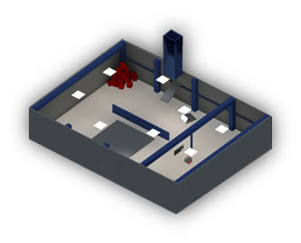
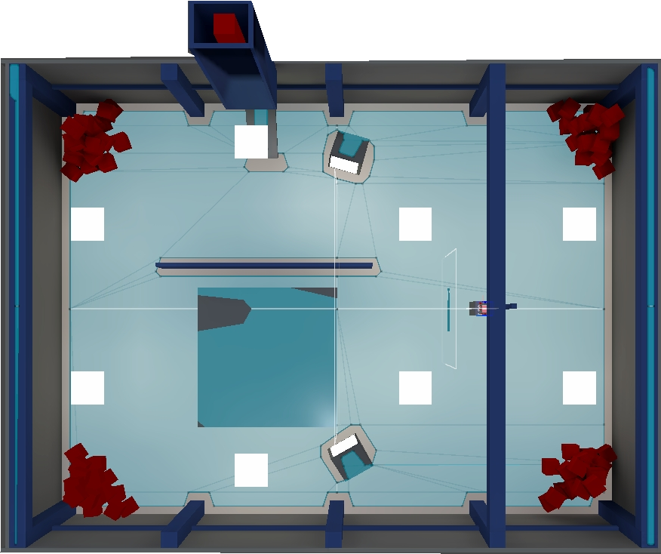
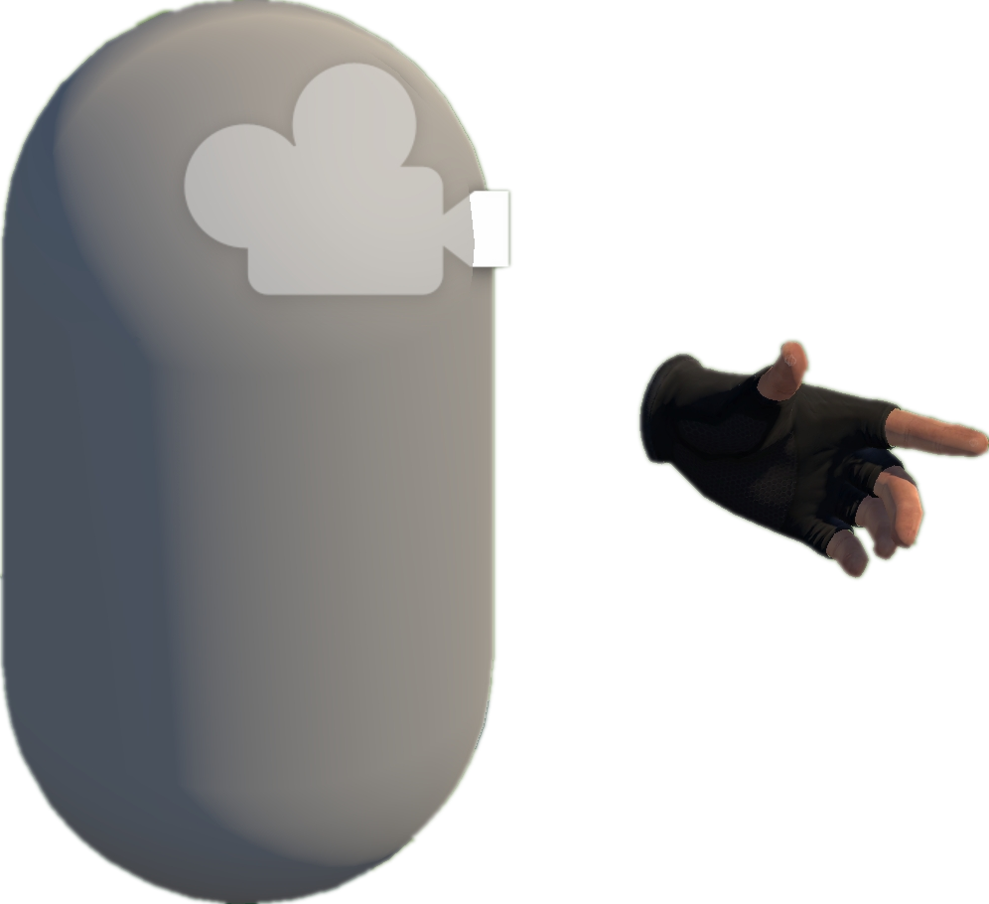








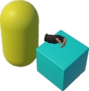
A
Project Collection (§3.2)
E
VRExplorer Test (§3.5)
Behavior Execution and Scene Exploration
3
Preliminary Scene Configuration
Open Source
Repositories
Tags & Topics
1
Camera
Unity-based
Projects
Hand Controller
Bake NavMesh
Collider
Quality Unity
VR Projects
Manifest Validation
& Manual Check
VRExplorer
Original Scene
Scene with NavMesh
Scene Analysis & Interaction
Implementation Interface
2
Entity Manager
Project Analysis (§3.2)
Customizing Entity Interface Configuration
List<BaseEntity > e;
B
Plugins/Tools/.dll
List<Mono > m;
Hierarchy Analysis
Game Logic Code & Third Plugin Analysis
Execute Task Asynchronously
Environment
Input the Next Interactable Object’s Mono
Interactables
Core C# Scripts
Mono Scripts Implemented Entity Interface
Box
Original Code
Task Generator
List<BaseAction> GetTask(BaseEntity [] e);
List<BaseAction> GetTask(Mono m);
EAT Framework (§3.4)
D
Output Current Task in the form of List<BaseAction>
C
Model Abstraction (§3.3)
Task Generator & Customized Task Model
Grab-And-Drag-Box Task
Abstraction Object Interaction Feature
Move to Approcach
Parallel Action
Parallel and serial combinations
Grab
Move Action
Grab Action
Triggerable
Base Action
Move Action
Button, Joystick
Triggerable & Grabbable
Inherit
Walk Around
Asynchronous Action
Gun, Cigarette Lighter
Grab Action
Trigger Action
Grabbable
Box, Coin
Grab
Base Entity
Trigger
EAT Framework
C# Scripts File
Abstraction Action
Inherit
Press
Pressing
Trigger Action
+ Triggering Time
+ Triggering() + Triggered()
Task Layer
Entity Interface
Pressed
Grabbable Entity
Triggerable Entity
Pull
Pulling
Action Layer
GameObjects
Relaxed
Implement
Entity Layer
Fire
Pulling the trigger
Unity Scene
Triggered
XR Box
XR Joystick
XR Button
Mono Layer
Third Plugin / .dll / Third Assembly
Notes:
单击此处添加文本

